Slide 1
骨架和蒙皮的生成
黄晓阳
2020年12月8日

Slide 2
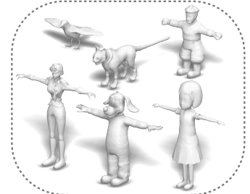
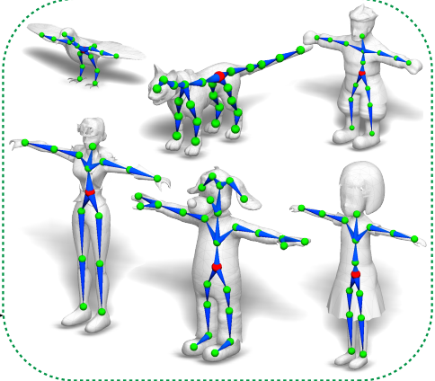
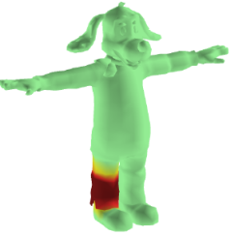
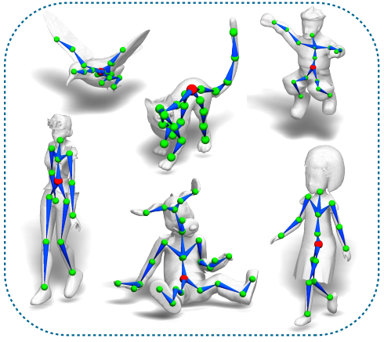
概念
骨架绑定（rigging）
蒙皮（skinning）
可以动了！

Slide 3
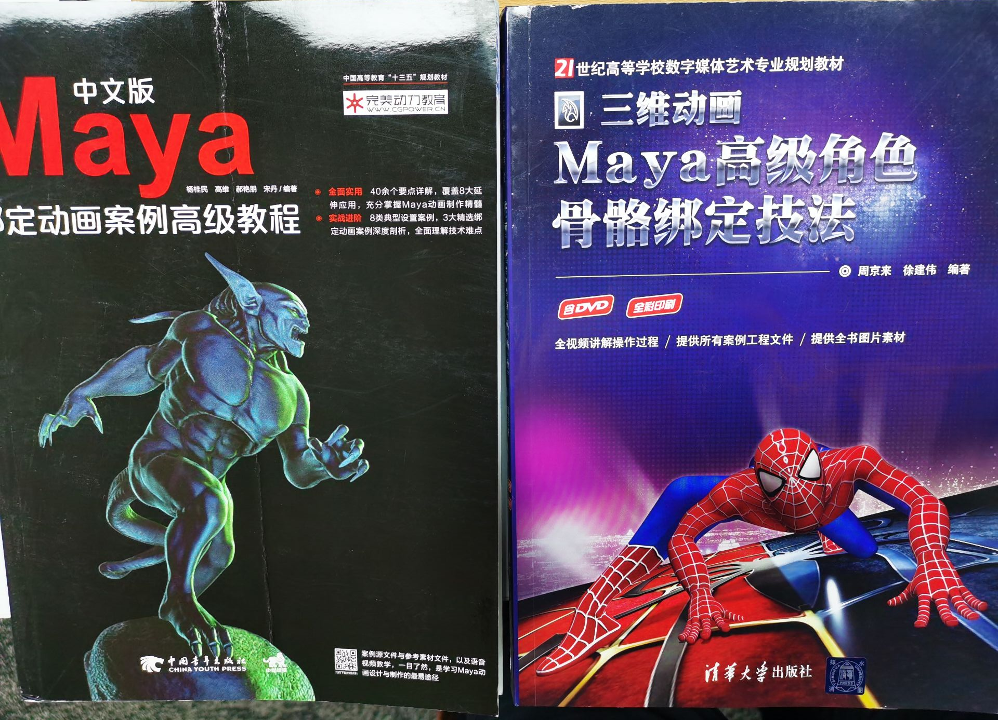
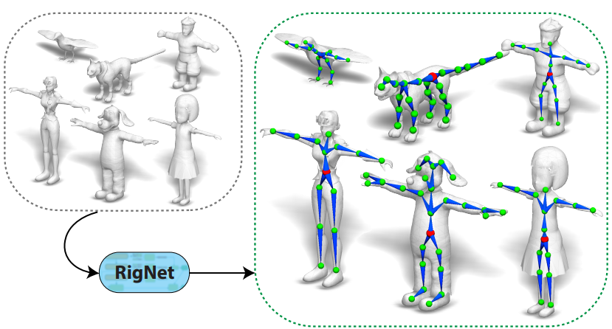
概念
一般由3D动画师用Maya软件创建（耗时耗人力，需要高级人才）
目前可通过Deep learning学习

Slide 4
RigNet
RigNet: Neural Rigging for Articulated Characters
特点：
端到端：关节预测+骨架预测+蒙皮
没有人型骨架的先验，适用于不同形态的生物体
高度工程化，工作量大，很多细微的设置

Slide 5
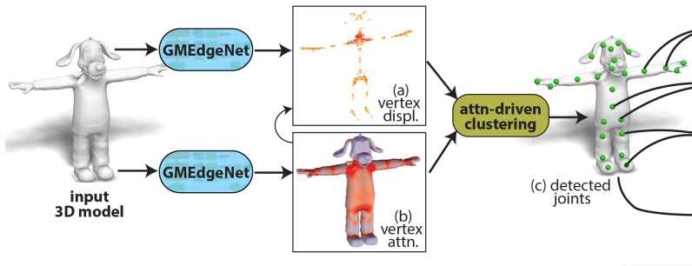
Stage1: joint prediction
Method：
Regression(per vertex)+clustering
Regression target: Closest joint of each vertex
Mean-shift clustering
No need to input the number of target clusters
differentiable

Slide 6
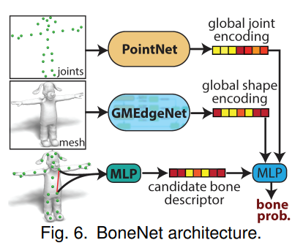
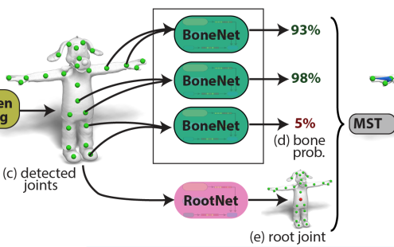
Stage2: connectivity(bones) prediction
Method：
Predict the probability of each candidate connection (BoneNet)
Candidate bone descriptor: joint coordinates, distance, proportion of the candidate bone lying in the exterior of the mesh
Using MST(最小生成树) to generate rigs

Slide 7
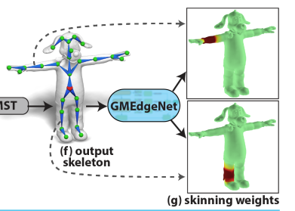
Stage3: skinning prediction
Method：
For each vertex: predict a softmax distribution over bones
Input feature: vertex coords + bones starting/ending point + volumetric geodesic distances to all the bones
Vertex coords
Vertex to bone 1
GMEdgeNet
K
Vertex to bone 2
…
Skinning weight over K bones for one vertex
Vertex to bone K
Input feature for one vertex

Slide 8
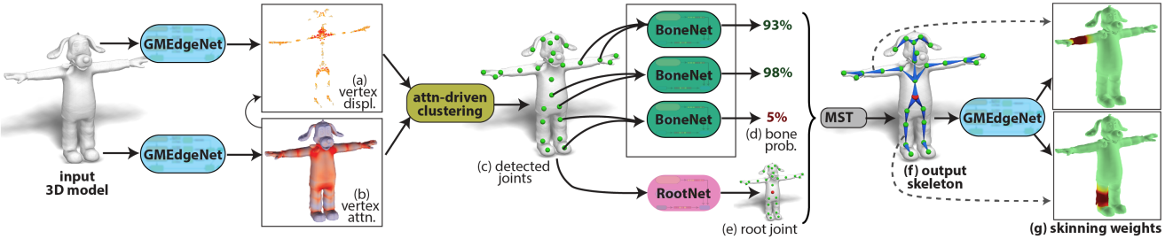
Total pipeline
Joint loss
Bone loss
Skining weights loss

Slide 9
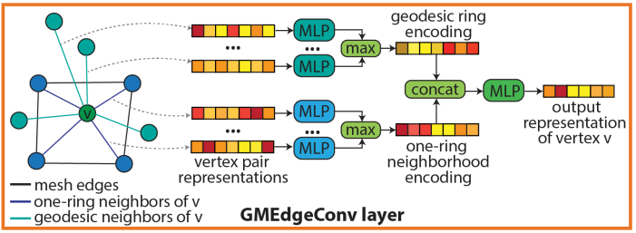
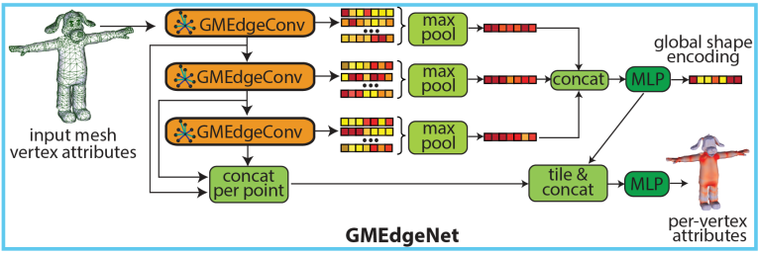
Details: GMEdgeNet
GMEdgeConv：
Input：graph (mesh)
Output：per-vertex attributes
Two MLPs: one for geodesic neighbors, one for topologic neighbors
GMEdgeConv plus global shape encoding form GMEdgeNet

Slide 10
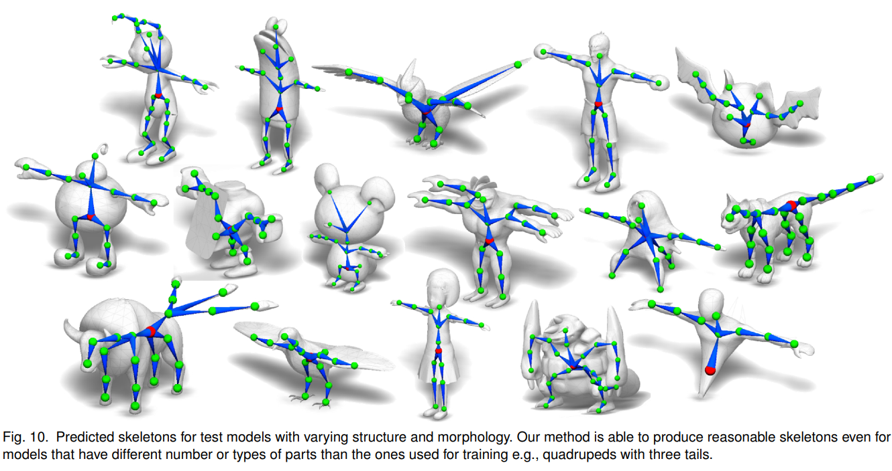
Details: GMEdgeNet

Slide 11
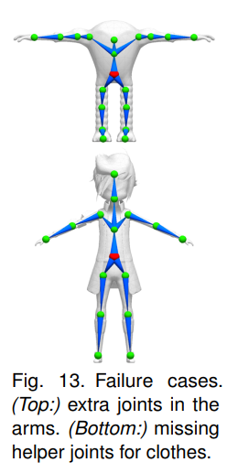
Limitations
“Our current bandwidth parameter explores one mode of variation.” (clustering)
‘’Many rigs often do not include bones for small
parts, like feet, fingers, clothing and accessories’’

Slide 12
感谢聆听

